Slide 1
CPSC 5200
Software Architecture and Design

Slide 2
Towards agile architecture
There is nothing special about architecture
Be aware of ivory tower architectures
Every system has an architecture
Architecture scales agile

Slide 3
Architecture throughout the lifecycle
Architecture happens all the time
It’s ok, really it is
You can start with an “iteration 0”
Identify the high-level scope
Identify the initial requirements stack
Identify an architectural vision
Then move into further iterations
Modeling is part of the planning effort
You need to model for good estimates
You need to plan the work
JIT through the issues
Keep stakeholders involved
Watch for evolving requirements
Just enough modeling
Test-first working software
Use executable specifications

Slide 4
Who is responsible for the architecture
This question is more complex than you think
Easy answer – everyone
This works great on smaller teams
But there are two problems
Sometimes, people don’t agree
It doesn’t scale (team size, geography, time, etc.)
Notes:
The easy answer, one that works well for small agile teams (which is the vast majority), is that everyone on the team is responsible for architecture.
When something is developed by a single person it becomes "their baby" and nobody likes to hear that their baby is ugly - when you find a problem with their architecture they are likely to resist any criticisms of it. When an architecture is developed by the entire team then people are often far more willing to rethink their approach because it's a team issue and not a personal issue.

Slide 5
Have an architecture owner
Often the more technically experienced person
More of a facilitator, not a dictator
This isn’t the traditional “software architect”
More collaborative in nature
The architect has final authority
Should have broader scope than just tech
Good understanding of the business domain
Solid communication skills
Ability to work outside of the technology
Notes:
Architecture owner is different than the traditional role of architect. In the past the architect would often be the primary creator of the architecture and would be one of the few people who worked on it. They would often develop the architecture and then "present it" to, or more accurately force it upon, the development team.
My thinking on this has evolved over the years and over many agile projects. In my opinion there’s no way to run an at-scale agile product (especially a product line, which we’ll talk about later this quarter) using a committee-driven approach. Certainly, there will be a group of one or more architects (or CTOs, or senior engineers, or something else) who are responsible for communicating and generally owning the architecture. However, you will likely need a single person who has ultimate say for cross-feature, cross-service, and cross-module decisions. The reason is simple – design by committee doesn’t work. As a co-worker of mine says “if everybody owns it, nobody owns it"

Slide 6
Principles of the agile architect
Value people
Communicate
Less is more
Embrace change – plan it, manage it
Choose the right solution for the enterprise (product, service)
Deliver quality
Model and document in an agile fashion
Notes:
You must recognize the value and importance of people. It's people who build success in software development, not machines, money, tools, technology or processes.
One of your primary tasks as an architect is to communicate with all the stakeholders. Only by communicating will you understand the goals, constraints and requirements. Only by communicating will you persuade others to adopt and maintain the right, high-quality, consistent solution. Focus on your audience. Use appropriate communications for each audience, matched to their skills, goals and needs.
Always model for a purpose, either to communicate, or to understand. Don't create models for other people unless you know how, and by whom, they will be used.
Some agile methods imply that the cost of change is very small. They "embrace change" by waiting until the customer says "Jump!", and then asking, "How High?" The Agile Architect knows this knee-jerk approach is wrong. Plan for change. Understand the likely directions of change, by looking forwards using techniques such as "scenario analysis" and "change cases" and looking backwards at previous changes.
Have courage in your decisions. Don't be defensive but be prepared to sell them. Listen to the arguments but avoid letting one stakeholder or concern dominate the decision-making process.
Plan and design for testing. Some agile processes (eXtreme Programming in particular) put testing first, before coding - this is a good practice to emulate. If you can not write the actual test scripts, you should still verify your understanding of any requirement by defining how it can be tested. Design the architecture to support testing: ensure the system is controllable, so that tests can be performed easily, and observable, so you can verify the test, or find out what has gone wrong.
Model light (Scott Ambler)
Model with a purpose
Multiple models
Know your models
Know your tools
Apply the right artifacts
Model in small increments
Model with others
Use the simplest tools
Apply modelling standards
Discard temporary models

Slide 7
The role of the agile architect
Understanding the requirements
Formulating the design
Communicating the architecture
Supporting the developers / team / everyone
Verifying the implementation
Notes:
Understanding the requirements - identifying the stakeholders, helping to analyze the requirements and extracting those of architectural significance
Formulating the design - creating a solution structure which will meet the various requirements, balancing the goals and constraints on the solution,
Communicating the architecture - making sure that everyone understands the architecture. Different people have different viewpoints, so the architect must present various views of the system appropriate to different audiences,
Supporting the developers – making sure that the developers can realize the architecture, by a combination of mentoring and direct involvement,
Verifying the implementation – ensuring the delivered system is consistent with the agreed architecture and will meet the requirements.

Slide 8
Agile architecture at scale
What do we mean by scale
Large agile teams (15+ is a good rule of thumb)
Smaller part of larger agile project
Geographically distributed
Enterprise-wide architectural efforts
Multiple teams and / or multiple concurrent development efforts

Slide 9
Strategies for scaling agile teams
Architecture-driven approach
Feature-driven approach
Open source approach
Or, some combination of the above
Notes:
Architecture-driven approach. With this strategy you organize your subteams around the subsystems/components called out in your architecture. This strategy works well when your architecture is of high quality (it's loosely coupled and highly cohesive) and the interfaces to the subsystems have been identified before the subteams really get going (the interfaces will evolve over time, but you want to get a good start at them initially). The challenge with this strategy is that it requires your requirements to be captured in a way which reflects the architecture. For example, if your architecture is based on large-scale business domain components then a requirement should strive to focus on a single business domain if possible. If your architecture is based on technical tiers -- such as a 3-tier architecture with user interface (UI), business, and data tiers -- then requirements should focus on a single tier if possible.
Feature-driven approach. With this strategy each subteam implements a feature at a time, a feature being a meaningful chunk of functionality to your stakeholders. I would apply this strategy in situations where the architecture exhibits a lot of coupling AND where you have sophisticated development practices in place. The challenge with this approach is that the subteams often need to access a wide range of the source code to implement the feature and thereby run the risk of collisions with other subteams. As a result these teams have sophisticated change management, continuous integration, and potentially even parallel independent testing strategies in place (to name a few).
Open source approach. With this strategy one or more subsystems/components are developed in an open source manner, even if it is for a single organization (this is called internal open source). This strategy is typically used for subsystems/components which are extensively reused by many teams, for example a security framework, and which must evolve quickly to meet the changing needs of the other systems accessing/using them. This strategy requires you to adopt tools and processes which support open source approaches.
Combinations thereof. Most agile teams at scale will combine the previous three strategies as appropriate.

Slide 10
Agile Architecture How-to

Slide 11
One process
Notes:
Envision the initial architecture. Minimally the architecture owner team is responsible for initial architecture envisioning and then bringing it to the sub teams for feedback and subsequent evolution. In the case of a large project there are often other agile team members involved with this initial modeling effort, including the product owner and even key project stakeholders. The architecture envisioning efforts can go on for several days and in the case of very large or complex project several weeks. For enterprise architecture efforts the enterprise architecture team will often include project-level application/solution architects in their initial modeling efforts and often executive stakeholders.
Working with the development teams. On large projects, the members of the architecture owner team will take active roles on the various subteams on the project, communicating the architecture to the subteams and working with them to prove portions of the architecture via concrete experiments. For enterprise architecture efforts, the enterprise architects will minimally act as consultants whose expertise is the corporate architecture, but better yet they will be active members of the critical project teams taking on the role of architecture owner on those teams. Due to the collaborative nature of agile development it is insufficient for architecture owners to simply do initial architecture envisioning, and perhaps "support" project teams by reviewing their work occasionally, but instead they must "roll up their sleeves" and become active members of the project teams. This will help them to avoid creating "ivory tower architectures" which sound good on paper yet prove impractical in the real world. It also helps to increase the chance that the project team(s) will leverage the architecture.
Communicating the architecture to architectural stakeholders. For project teams the architectural stakeholders include the product owner(s) working with the agile delivery team(s), key project stakeholders, and of course the rest of the development team. These people need to understand the architecture vision, the trade-offs that have been made, and the current status of where you are implementing the architecture.
Updating architectural work products. The architecture owner team will find that they need to get together occasionally to evolve the architecture as the project progresses, negotiating changes to the architecture and updating their architectural model(s), if any, as appropriate. These meetings will be frequent at the beginning of a project and will be needed less and less as the architecture solidifies. It will be common for members of the development subteams, who may not be members of the core architecture team, to attend some meetings to present information, perhaps they were involved with some technical prototyping and have findings to share with the architects. The best meetings are short, often no more than an hour in length, and are often held standing up around a whiteboard - everyone should come prepared to the meetings, willing to present and discuss their issues as well as to work together as a team to quickly come to resolutions.

Slide 12
Requirements-driven architecture
If your architecture isn’t based on requirements, you’re hacking
Requirements come from stakeholders
Base architecture on
Technical requirements, constraints, change cases
Essential use cases / user stories, business rules
DO NOT ignore existing artifacts
Architectural modeling occurs early, not first
Always invest time understanding the requirements first
Notes:
Good sources of requirements
Users and their direct management
Operations staff
Sometimes senior management (internal-facing enterprise software)
Don’t ignore existing documentation such as network and infrastructure diagrams, in-place security models, corporate standards, and so on. Yes, they may be out of date (most documentation typically is) but at least look them over and use what you can. Sometimes having that history can save you countless hours later.
Most software exists within the context of many teams – operations, management, user groups, the press, finance, human resources, other development teams. If you ignore these teams you will fail. It’s that simple.

Slide 13
Model your architecture
Primary goal: a common vision or understanding
Experience says that 99.999% of all teams need to do this
You will likely sketch models of your system
You can throw these away later
There’s nothing wrong with drawing models
Some of the models
Start with a roadmap
No one set of views is applicable for every project
Let your project guide your models
DO NOT model your organization
DO NOT let your organization dictate the models you create
Notes:
Watch out for instances of Conway’s Law kicking in. Building an architecture (or product, or product line) that mimics your organization is extremely easy to do and happens to be very natural. You do not want your customers to see the seams (ok, let’s call them cracks because that’s what they really are) in your organization. There are times and places for breaking a product into components that look like your org. These are rare and this is done only in extreme cases.
The flipside of this is actually more reasonable. It makes tons of sense to organize around an architecture. However, if you have an architecture that’s loosely coupled around some “service” or “tier” or other component structure, then you can build your organization around this same structure. But don’t go the other way.

Slide 14
Architecture modeling principles
Discard temporary models
Apply the right artifacts
Create multiple models
Create simple content
Use the simplest tools
Depict models simply
Apply patterns gently
Model in small increments
Formalize contract models
Notes:
Most of the models that you will create are temporary/working models -- design sketches, low fidelity prototypes, index cards, potential architecture/design alternatives, and so on -- models that have fulfilled their purpose but no longer add value now that they have done so. Models quickly become out of sync with the code, and there is nothing wrong with that. You must then make the decision to synchronize the models if doing so adds value to your project or to simply discard them because the investment to update the models won't be recouped by the value of having done so (there's negative payback). This practice is particularly important for agile documentation.
Each artifact has its own specific applications. For example, a UML activity diagram is useful for describing a business process, whereas the static structure of your database is better represented by a physical data or persistence model. Very often a diagram is a better choice than source code -- If a picture is worth a thousand words then a model is often worth 1024 lines of code when applied in the right circumstances (a term borrowed from Karl Wieger's Software Requirements) because you can often explore design alternatives more effectively by drawing a couple diagrams on whiteboards with your peers than you can by sitting down and developing code samples. The implication is that you need to know the strengths and weaknesses of each type of artifact, so you know when and when not to use them. Note that this can be very difficult because you have Multiple Models available to you.
You potentially need to use multiple models to develop software because each model describes a single aspect of your software. “What models are potentially required to build modern-day business applications?” Considering the complexity of modern-day software, you need to have a wide range of techniques in your intellectual modeling toolkit to be effective. An important point is that you don't need to develop all these models for any given system, but that depending on the exact nature of the software you are developing you will require at least a subset of the models. Different systems, different subsets. Just like every fixit job at home doesn't require you to use every tool available to you in your toolbox, over time the variety of jobs you perform will require you to use each tool at some point. Just like you use some tools more than others, you will use some types of models more than others.
You should keep the actual content of your models -- your requirements, your analysis, your architecture, or your design -- as simple as you possibly can while still fulfilling the needs of your project stakeholders. The implication is that you should not add additional aspects to your models unless they are justifiable -- if you do not have a requirement to add system auditing features then don't add that features to your models. Have the courage to trust that you can in fact add this feature when, and if, it is ever asked of you. This is along the lines of XP's practice of Simple Design.
Most models can be drawn on a whiteboard, on paper or even the back of a napkin. Whenever you want to save one of these diagrams you can take a picture of it with a digital camera, or even simply transcribe it onto paper. This works because most diagrams are throwaways; their true value comes from drawing them to think through an issue, and once the issue is resolved the diagram doesn't offer much value. As a result a whiteboard and markers are often your best modeling tool alternative: Use a drawing tool to create diagrams to present to important project stakeholders and occasionally use a modeling tool if and only if they provide value to my programming efforts such as the generation of code. Think of it like this: If you're creating simple models, often models that are throwaways because if you are modeling to understand you likely don't need to keep the model(s) around any more once you do understand the issue, then you likely don't need to apply a complex modeling tool.
When you consider the potential diagrams that you could apply (UML diagrams, user interface diagrams, data models, and so on) you quickly realize that the majority of the time you only require a subset of the diagramming notation available to you. A simple model that shows the key features that you are trying to understand, perhaps a class model depicting the primary responsibilities of classes and the relationships between them, often proves to be sufficient. Yes, you could model all the scaffolding code that you will need to write, all the getter and setter operations that your coding standards tell you to use, but what value would that add? Very little.
Effective modelers learn and then appropriately apply common architectural, design and analysis patterns in their models. However, as Martin Fowler points out in Is Design Dead? developers should consider easing into the application of a pattern, to apply it gently. This reflects the value of simplicity. In other words, if you SUSPECT that a pattern applies you should model it in such a way as to implement the minimal amount you need today but that makes it easy to refactor it later when it is clear that applying the full-fledged pattern is in fact the simplest approach possible. In other words, don't over model. For example, you may recognize a good spot in your design to apply the GoF's Strategy pattern, but at the current moment you only have two algorithms to implement. The simplest approach might be to encapsulate each strategy in its own class and build an operation that chooses them appropriately and passes them the appropriate input. This is a partial implementation of Strategy that leaves you in a position to refactor your design if more algorithms need to be implemented, yet does not require you to build all the scaffolding that Strategy requires -- an approach that enables you to ease into application of the pattern.
Incremental development in which you organize a larger effort into smaller portions that you release over time, hopefully in increments of several weeks or a month or two, increases your agility by enabling you to deliver software into the hands of your users faster.
Contract models are often required when an external group controls an information resource that your system requires, such as a database, legacy application or information service. A contract model is something that both parties should mutually agree to and mutually change over time if required. Examples of contract models include the detailed documentation of an application programming interface (API), a file layout description, an XML DTD or a physical data model describing a shared database. As with a legal contract, a contract model often requires you to invest significant resources to develop and maintain the contract to ensure that it's accurate and sufficiently detailed. Your goal is to minimize the number of contract models for your system to conform to the XP principle of traveling light. Note that you will almost always use an electronic tool to develop a contract model because the model must be maintained over time.

Slide 15
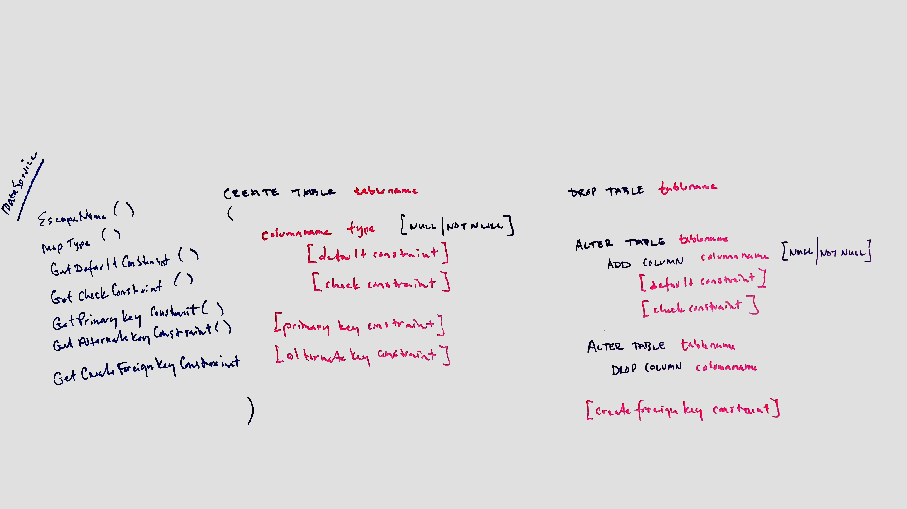
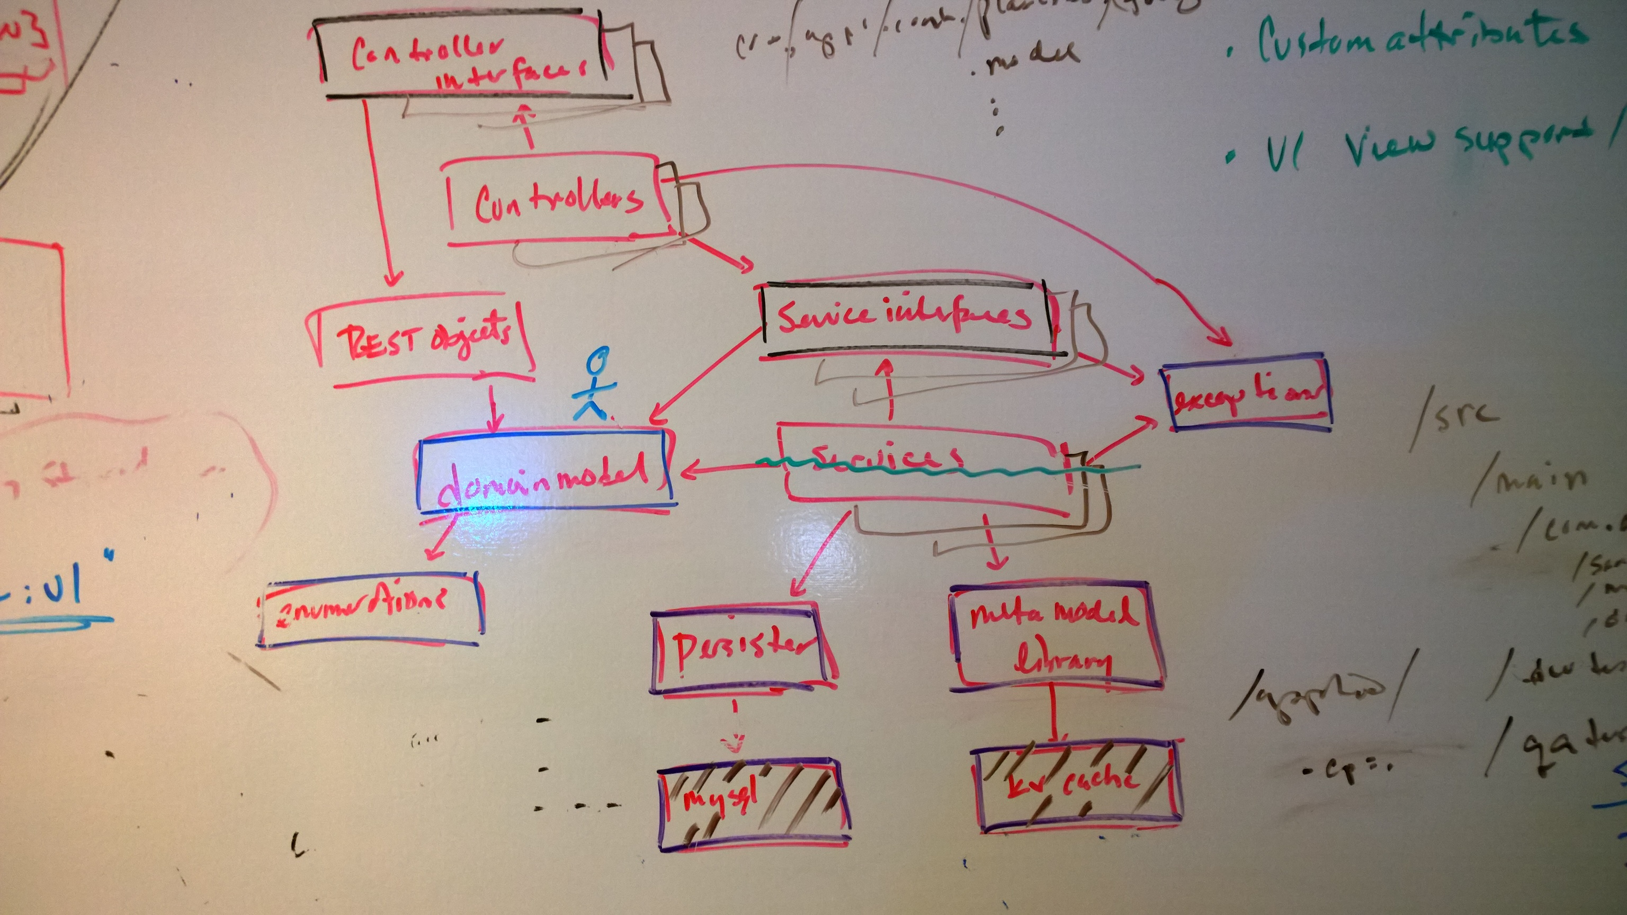
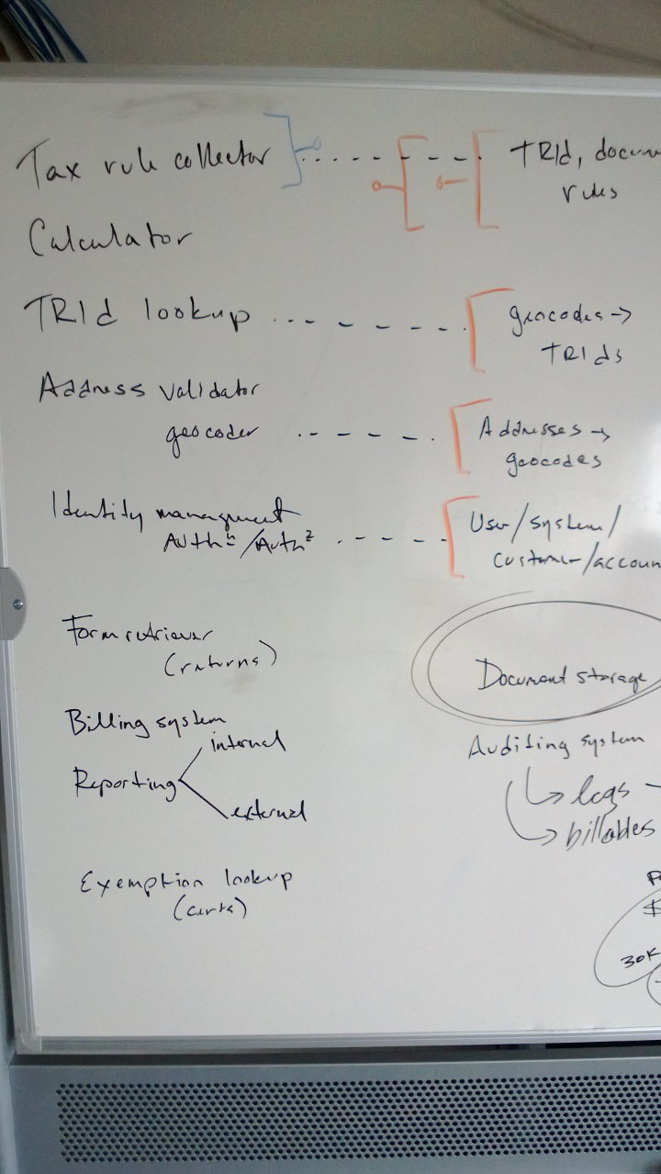
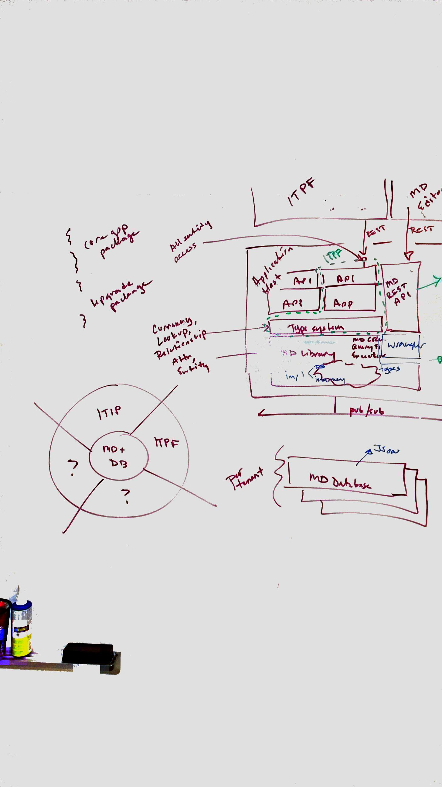
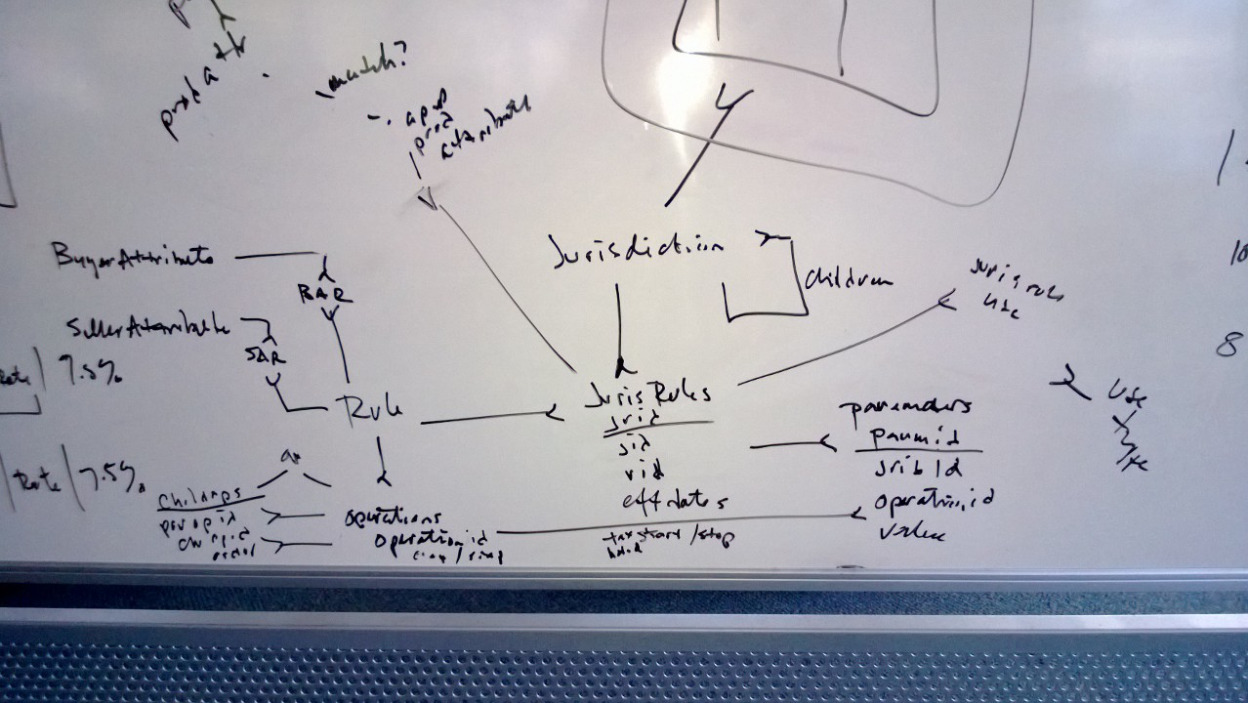
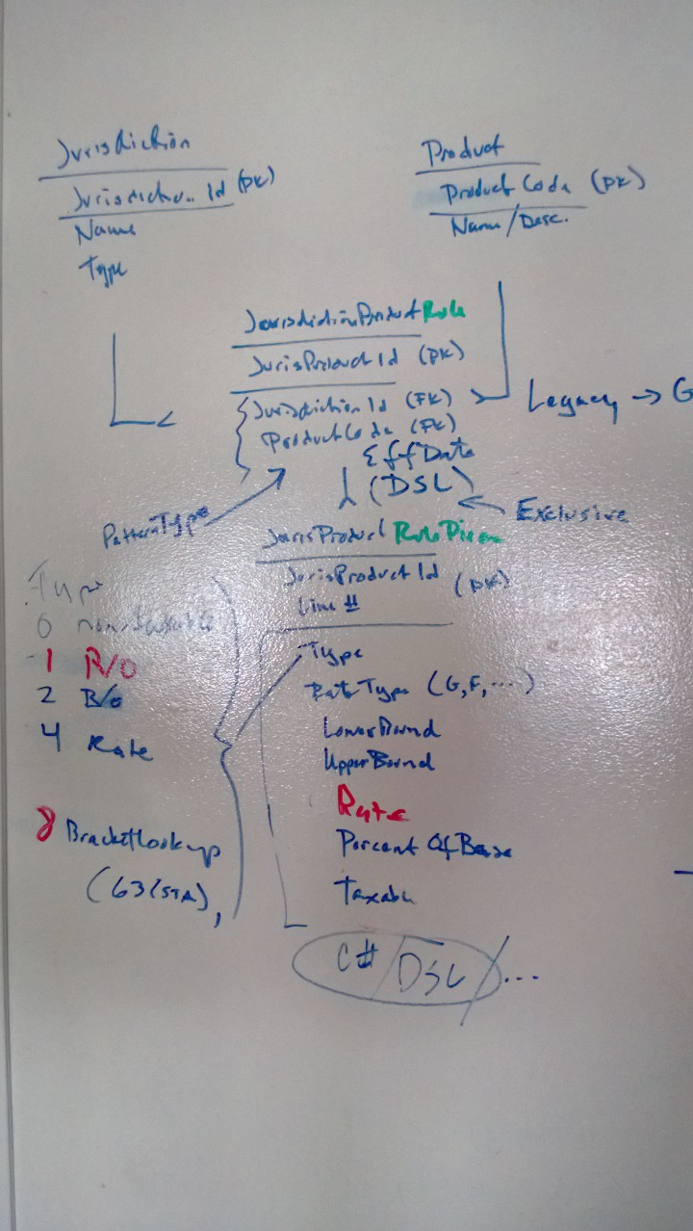
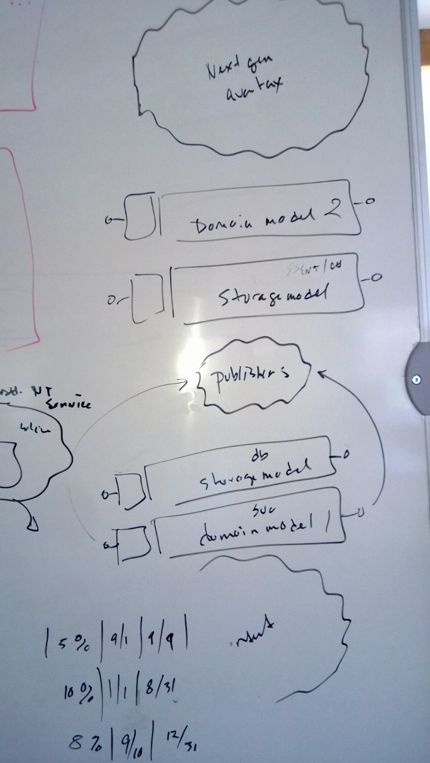
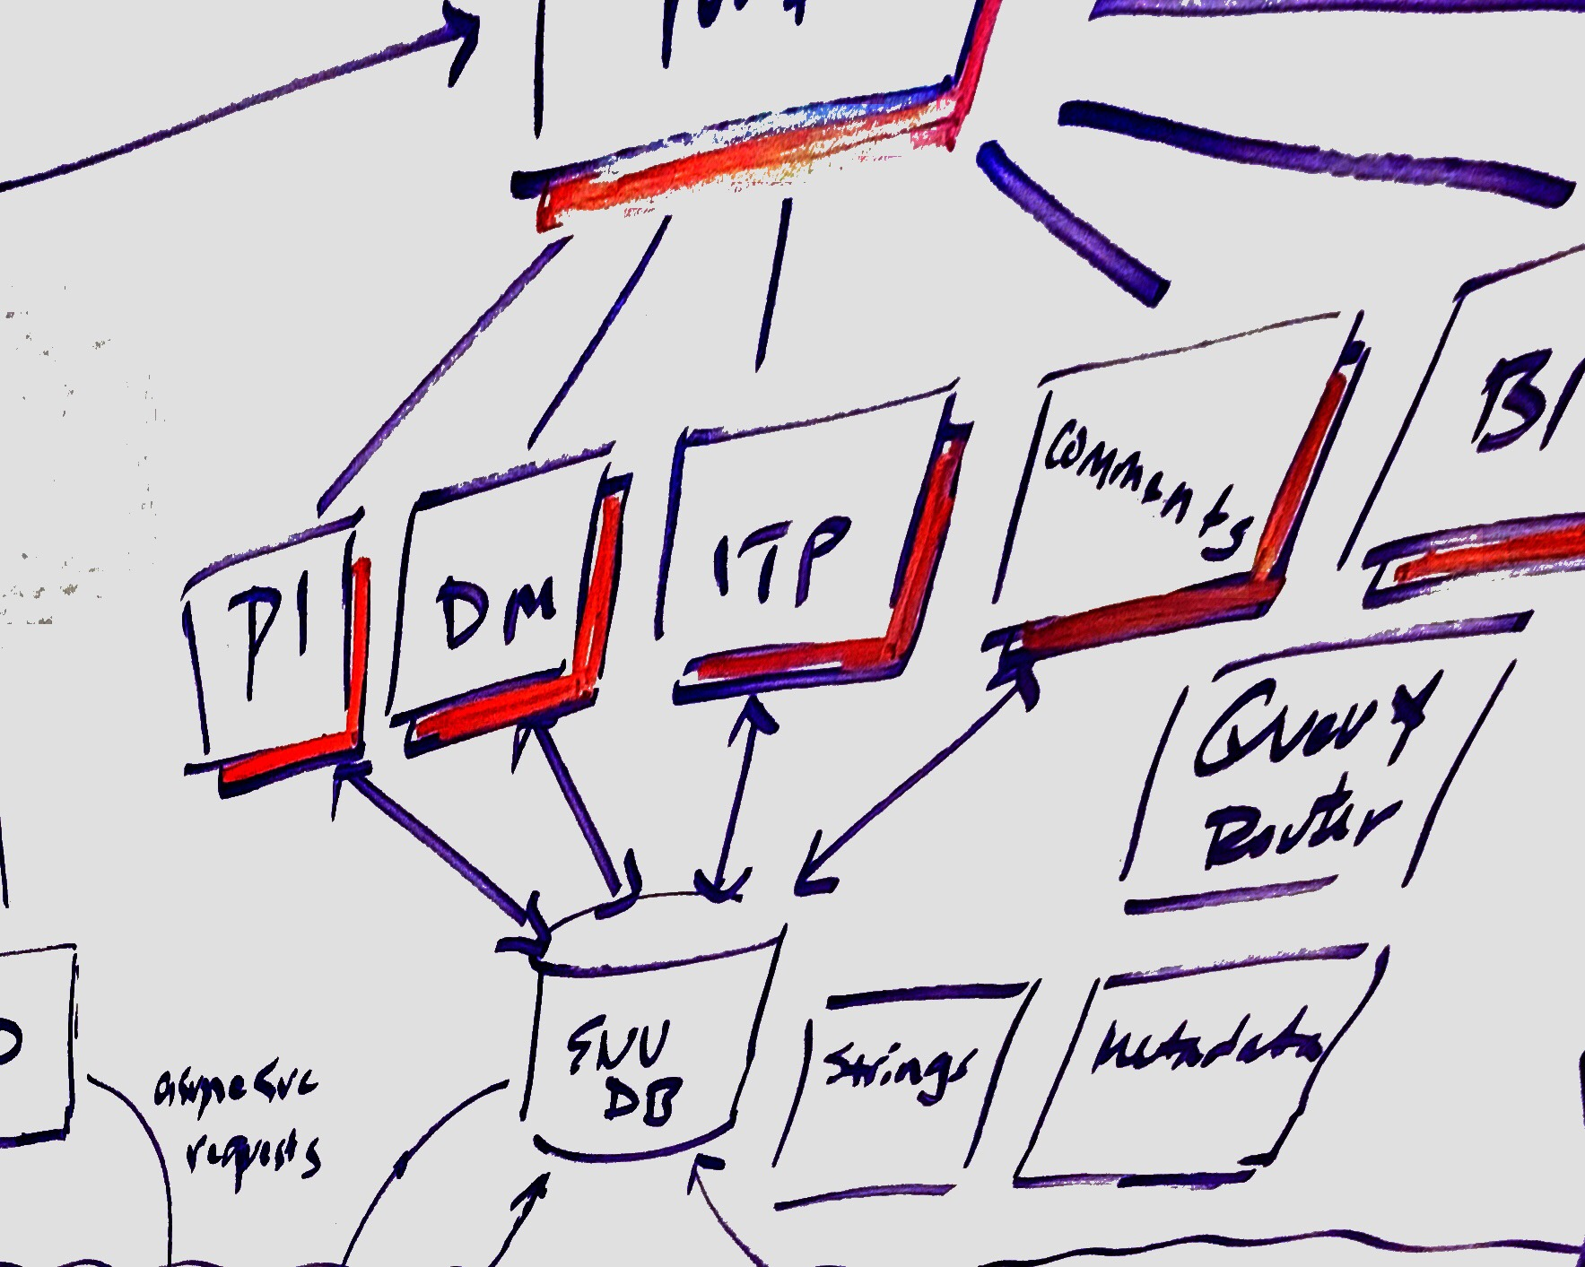
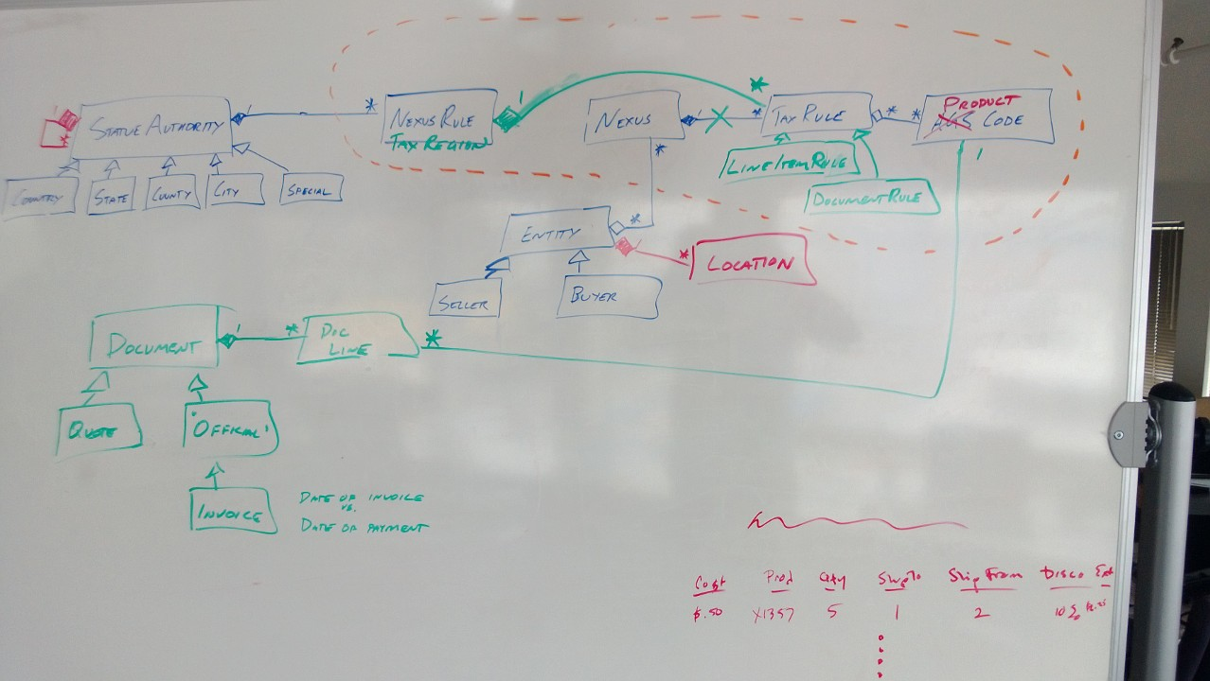
Whiteboard modeling is a real thing

Slide 16
Remember the enterprise
A “to be” vision for their technical infrastructure
Enterprise-level standards and guidelines
A strategic reuse strategy for reducing costs
Enterprise Architecture, Strategic Reuse, etc. groups
Operations and support organizations
Notes:
These are all important stakeholders in the process.
The point is that these enterprise-level considerations provide both challenges and opportunities to development teams. Although it would be wonderful to start with a clean architectural slate every time you build a new system, the reality is that strategy would be very inappropriate in most situations.
I've seen several agile project teams over the years that have been abysmal failures because they chose to start fresh, claiming that their architecture emerged over time, that they had the courage to worry about tomorrow's problem tomorrow, that they produced potentially shippable software on a regular basis, and basically parroting any other agile rhetoric which they believed justified their fooling around.
Disciplined teams build systems whose architecture emerges within the organizational environment in which they're working. They have the humility to recognize that they're not able to make all of the technical decisions which they would like to, but instead are constrained by the existing infrastructure and vision for it. Furthermore, they produce potentially consumable solutions which work within their organization's ecosystem.

Slide 17
Travel light
Be as agile as possible
Don’t create a 50-page document when 5 pages will do
Don’t create a 5-page document when a picture will do
Don’t create a picture when a metaphor works
Err on the side of too little, you can always add more
You don’t ship your architecture documentation
Notes:
When will you want to write architectural documentation? There are two instances where it makes “agile sense”. First, when you have a distributed development team and you cannot find a more effective manner of communication, such as face-to-face conversation, then documentation is an option. Second, at the end of a project when you want to leave behind sufficient documentation so that someone else can understand your approach later on. The reality is that for reasonably complex systems it's incredibly difficult, if not impossible and certainly not desirable, to document everything in your code. Sometimes the best place to describe your architecture is in a brief overview document. This document should focus on explaining the critical aspects of your architecture, likely captured by your navigation diagrams, it might include a summary of key architectural requirements, and an explanation of the critical decisions behind "questionable" aspects of what you did. As always, if you're going to create an architecture document then it should add positive value and should ideally do so in the most effective way possible.

Slide 18
Prove your architecture
Remember, your model is just an abstraction
Prove that it works through implementation
If it’s new spend the time to investigate it
If it’s new remember to ask for permission to use it
Set out to find, and address, the risk factors early
Work with the product owner to prioritize risk investigations

Slide 19
Communicate your architecture
Display your models publicly
Practice open and honest communication
Remember collective ownership
Understand the target audience
Developers and other stakeholders may have different needs
Model with a purpose
Be prepared to communicate your architecture in a presentation
Notes:
I’ve worked on teams that have covered entire hallways with models. One team took over a conference room and used string, tape, sticky notes, and the whiteboard to construct, validate, and communicate their models. If you post a model, post the right one. If your model is out of date but nearly correct, be honest and mark it up. If you’ve left a dead model stinking up the place, you’re only hurting yourself.
As you get more experience and more visibility you will be asked to present your architecture (or, more likely, your team’s architecture) to various stakeholders. These people will have technical abilities that range from zero to far more technical than you. Be prepared to discuss your models and the justification behind them, and be prepared to go wide or deep depending on the audience. I keep multiple architecture “documents” just for this purpose: deep for the developers, high-level for management and cross-team, marketing-focused for customers, security-focused…. You get the idea.

Slide 20
Think about the future
Overbuilding leads to serious trade-offs
It’s hard to estimate the actual value
You’re guessing
You’re increasing your maintenance burden
It isn’t clear to what extent it needs to be tested
Be smart about it
Do some initial architecture envisioning, and document it
Defer commitment to the last possible moment, and no later
Notes:
Change cases
An interesting strategy is change case modeling. Change cases are used to describe new potential requirements for a system or modifications to existing requirements. Change cases are requirements you may, or may not, need to support in the future but you definitely do not need to support today. Change cases are often the result of brainstorming with your project stakeholders, where questions such as:
“How can the business change?”
“What legislation can change?”
“What is your competition doing?”
“Who else might use the system and how?”
On the technical side developers will often ask fundamental questions such as “What technology can change?” and “What systems will we need to interact with?” that will lead to the identification of change cases.
Change cases should be realistic, for example “We enter the insurance business” for a bank or “We need to support the [INSERT FLASHY NEW TECHNOLOGY] in our system” are reasonable change cases but “Our sales staff is abducted by UFOs” isn't. Furthermore, change cases typically describe requirements that are reasonably divergent from what you are currently working on, requirements that would potentially cause major rework to fulfill. By identifying change cases you are now in a position to intelligently choose between what would otherwise appear to be equal architectural or design decisions. You should only bring relevant change cases into the decision making process when your current requirements are not sufficient to help you to choose between alternatives. Another advantage is you can now explain to your project stakeholders why you chose one approach over another. You have a story to tell. However, I cannot stress enough that change cases should not be used as excuses to gold plate your system. Stay agile and don't overbuild your system. So what do you do when you think you have a change case that you truly believe needs to be implemented now? Simple - discuss it with your project stakeholders. Ask them if the change case is an immediate requirement, and if so act accordingly. If it isn't an immediate requirement then accept the fact and move on. Never forget that it is the project stakeholder's responsibility to prioritize requirements, not yours.

Slide 21
For class reading
http://www.scaledagileframework.com/Agile-Architecture/
https://www.thoughtworks.com/talks/agile-architecture-rethink-2014
http://www.agilearchitect.org/agile/principles.htm

